Slide 1


Project Title
Market Basket Analysis
Team Members
Ravula.Nagaveni(TeamLeader)
P.Dhana Sri
M.Jyothika

Slide 2
MARKET BASKET ANALYSIS

Slide 3
Abstract
Market basket analysis (i.e. Data mining technique in the field of marketing) is the method to find
the associations between the items / item sets and based on those associations we can analyse the
customer behaviour. In this research we have presented the variability of time, because with the
change in time the habits or behaviour of the customer also changes. For example, people wear
warm clothes in winter and light clothes in summer. Similarly, customers purchase behaviour also
changes with the change in time. We study the problem of discovering association rules that
display regular cyclic variation over time. This problem will allow us to access the changing trends
in the purchase behaviour of customers in a retail market, and we will be able to analyse the results
which will display the changing trends of the association rules. In this research we will study the
interaction between association rules and time.

Slide 4
Aim of MBA
TO PERFORM MARKET BASKET ANALYSIS
To help the customers finding relevant products
Performing the “Apriori Algorithm” on the market basket dataset.
Market basket analysis targets customer baskets in order to monitor buying patterns and improve customer. It is an important component of analytical CRM in retail organizations. By analyzing, recurring patterns in order to offer related goods together, a pattern can be found and therefore the sales can be increased.

Slide 5
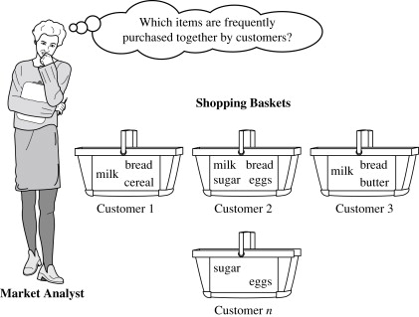
Objective of MBA * To find frequency purchased item sets from large transactional data base.

Slide 6
INTRODUCTION
Market Basket Analysis is one of the key techniques used by large retailers to uncover association between items.
It works by looking for combinations of items that occur together frequently in transactions.
It allows another way like retailers to identify relationships between the items that people buy.

Slide 7
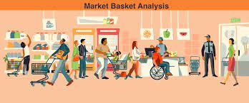

Slide 8
Data Collection and Info
Source
Shape
Null Values
Duplicate Values
Missing Values
Categorical Variables

Slide 9
Data preprocessing and EDA
Missing Values
Encode Categorical Variables
Scale Numerical Features
Understanding the Dataset
Data Visualization
Correlation Analysis

Slide 10
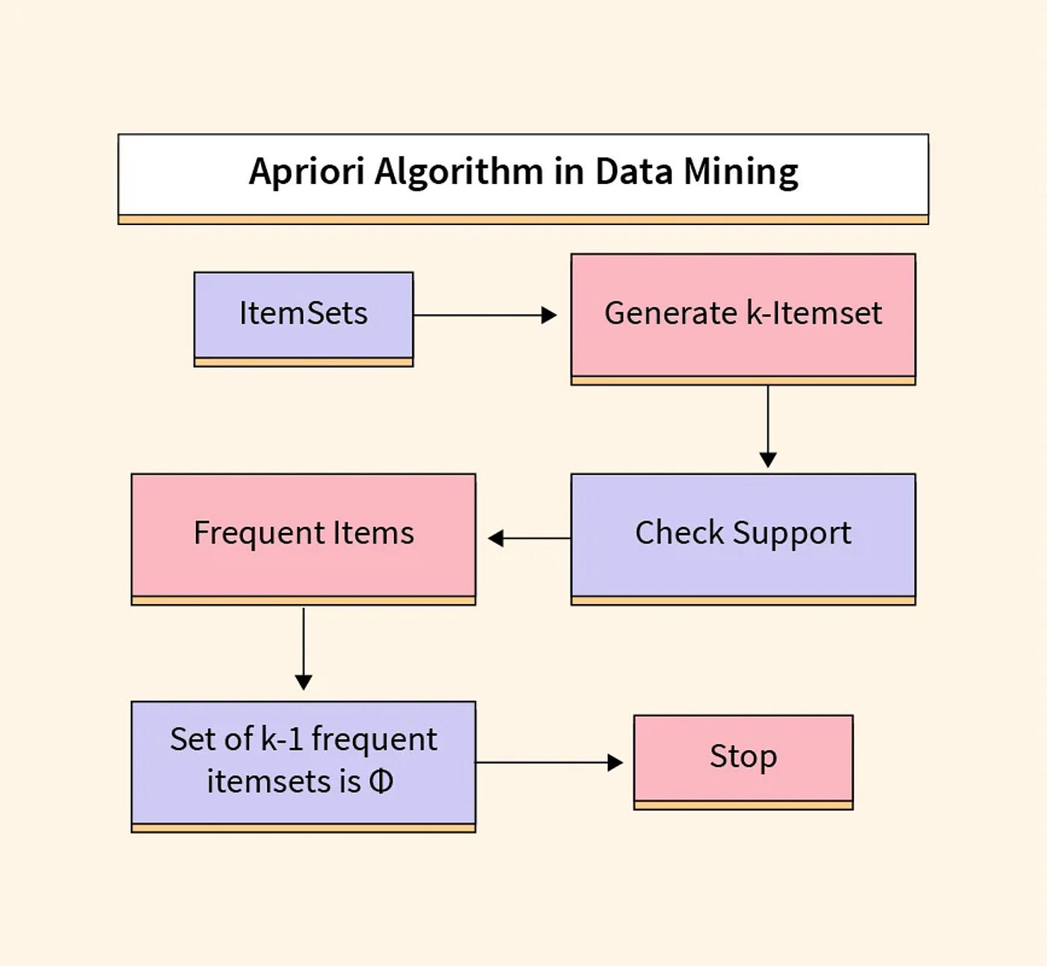
Select Model & Training Model
Model : “APRIORI ALGORITHM”
Apply APRIORI to Dataset
Generating Association Rules

Slide 11
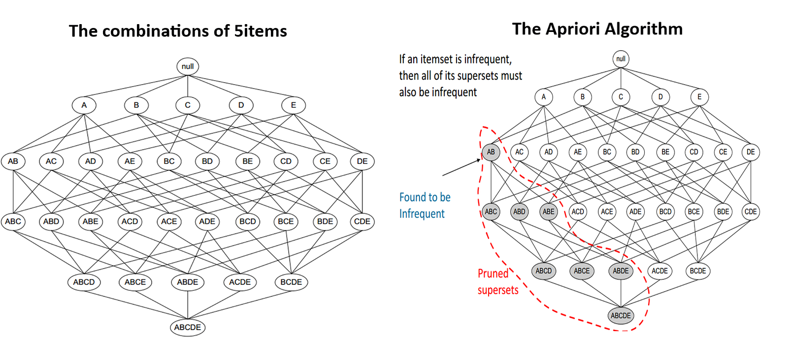

Slide 12
Association Rule Mining
Association Rule Mining is used when you want to find an association between different objects in a dataset, find frequent patterns in a transaction database, relational databases or any other information repository.
The application of Association Rule Mining are found in Marketing, Basket Data Analysis in retailing ,clustering and classification

Slide 13
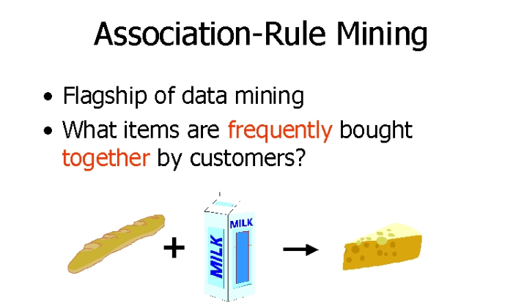

Slide 14
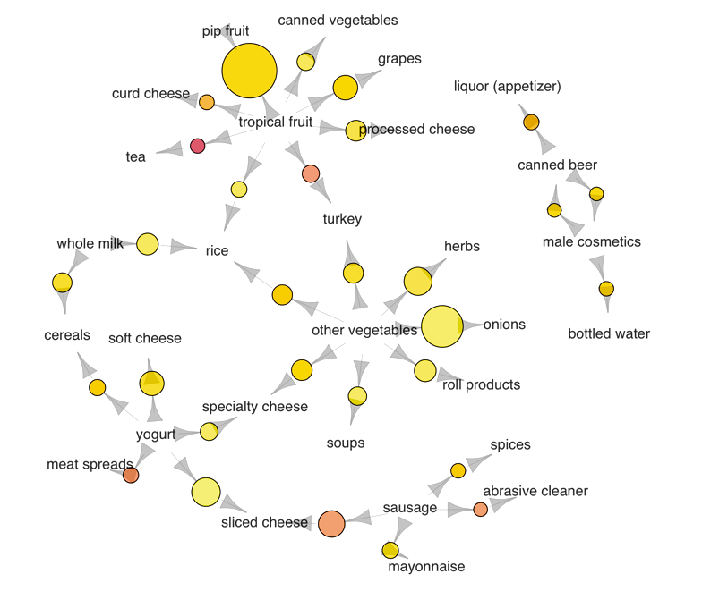

Slide 15
Marketing Strategies
Changing the store layout according to trends
Customer behavior analysis
Catalog design
Cross marketing on online stores
What are the trending items customers buy
Customized emails with add-on sales etc.

Slide 16
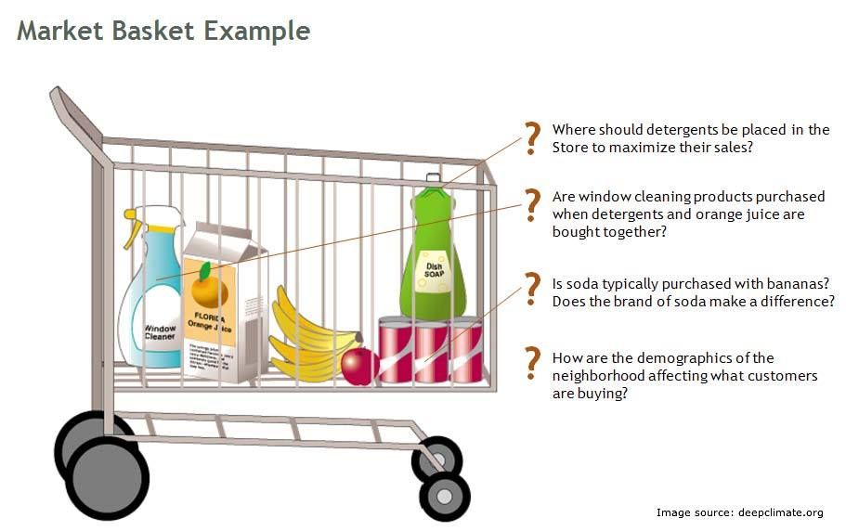
Example of Market Basket Analysis
One itemset might be : {pencil, paper, staples, rubber} in which case all of these items have been bought in a single transaction.
In this example one rule could be: { pencil, paper} => {rubber}.This means that if a customer has a transaction that contains a pencil and paper , then they are likely to be interested in also buying a rubber.

Slide 18
Terms used in Market Basket Analysis
There are three terms mainly used in MBA is :
1.Support : The percentage of transactions that contain all of
the items in an itemset. The higher the support the
more frequently the itemset occurs.
2.Confidence : The probability that the transaction that contains
the items on the left hand side of the rule also
also contains the item on the right hand side.

Slide 19
Advantages of MBA
Easy to implement.
Easy to start.
Flexible data formats.
Simplicity
Better Price Strategies
Sales Growth

Slide 20
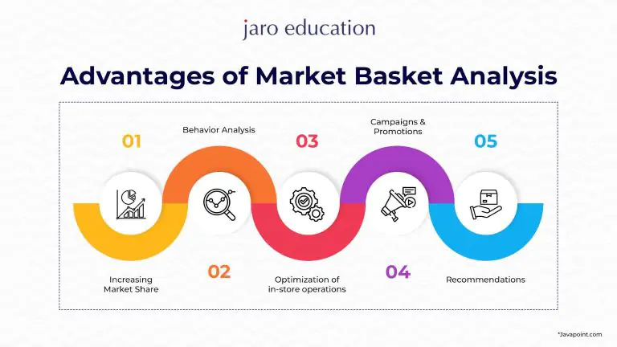

Slide 21
Disadvantages of MBA
Exponential Growth in computation.
Rule selection.
Not suitable for rare items.

Slide 22
Problems in MBA
Level of frequency of appearance determination.
Finding strong association among frequent items.

Slide 23
Applications of MBA
1. Retail: Market basket research is frequently used in the retail sector to examine consumer buying patterns and inform decisions about product placement, inventory management, and pricing tactics. Retailers can utilize market basket research to identify which items are sluggish sellers and which ones are commonly bought together, and then modify their inventory management strategy accordingly.
2. E-commerce: Market basket analysis can help online merchants better understand the customer buying habits and make data-driven decisions about product recommendations and targeted advertising campaigns. The behaviour of visitors to a website can be examined using market basket analysis to pinpoint problem areas.
3. Finance: Market basket analysis can be used to evaluate investor behaviour and forecast the types of investment items that investors will likely buy in the future. The performance of investment portfolios can be enhanced by using this information to create tailored investment strategies.
4. Telecommunications: To evaluate consumer behaviour and make data-driven decisions about which goods and services to provide, the telecommunications business might employ market basket analysis. The usage of this data can enhance client happiness and the shopping experience.
5. Manufacturing: To evaluate consumer behaviour and make data-driven decisions about which products to produce and which materials to employ in the production process, the manufacturing sector might use market basket analysis. Utilizing this knowledge will increase effectiveness and cut costs.

Slide 24
Functions of MBA
Finding set of items that have significant impact on business.
Collecting information, From numerous transactions.
Generating rules from counts in transactions.

Slide 25
Conclusion
Market basket analysis has revealed valuable insights into consumer behavior and purchasing patterns within our retail (or e-commerce) environment. Through the examination of transaction data and the application of association rule mining techniques, we have uncovered significant relationships between products, enabling us to better understand customer preferences and optimize various aspects of our business operations.
Identification of frequently co-occurring items: We have identified associations between products that are frequently purchased together, allowing us to identify cross-selling opportunities and optimize product placements within our stores (or website).
Understanding customer behavior: The analysis has provided insights into customer preferences and buying habits, allowing us to tailor marketing strategies and promotional activities to better meet their needs.
Optimization of inventory management: By understanding which products are often purchased together, we can improve inventory management practices, ensuring that popular items are adequately stocked while minimizing overstocking of less frequently purchased products.
Enhancement of personalized recommendations: The insights gained from market basket analysis can be leveraged to enhance personalized recommendation systems, providing customers with more relevant product suggestions based on their past purchasing behavior.

Slide 26
Future Work
Incorporating additional data sources: Future analyses could benefit from the inclusion of additional data sources, such as customer demographics, weather patterns, or seasonal trends, to provide a more comprehensive understanding of consumer behavior.
Real-time analysis and dynamic recommendations: Implementing real-time market basket analysis techniques would allow us to adapt our recommendations and marketing strategies on-the-fly, based on the latest transaction data.
Integration with other analytical techniques: Combining market basket analysis with other analytical techniques, such as customer segmentation or sentiment analysis, could provide deeper insights into consumer behavior and preferences.
Evaluation of the impact of recommendations: Conducting experiments or A/B tests to evaluate the effectiveness of personalized recommendations generated from market basket analysis in driving sales and improving customer satisfaction.
Exploration of outlier detection and anomaly detection techniques: Investigating outlier detection methods could help identify unusual or unexpected purchasing patterns that may warrant further investigation.

Slide 27
THANK YOU

